Slide 1
Tivoli Storage Manager Solutions for Hierarchical Storage Management
HSM Deep Dive Day
America 2008
Tivoli Software Development – Tivoli Storage Manager
IBM Deutschland GmbH
Fabián Kuhl
Stefan Bender

Slide 2
Tivoli Storage Manager Solutions for Hierarchical Storage Management – HSM deep dive day
Disclaimer
This presentation describes potential future enhancements to the
IBM Tivoli Storage Manager family products.
All statements regarding IBM's future direction and intent are subject to change or withdrawal without notice, and represent goals and objectives only.
Information in this presentation does not constitute a commitment to deliver the described enhancements or to do so in a particular timeframe
IBM reserves the right to change product plans, features, delivery schedules according to business needs and requirements.

Slide 3
Tivoli Storage Manager Solutions for Hierarchical Storage Management – HSM deep dive day
HSM deep dive day America 2008 – Overall Agenda
09:30 am - 10:15 am
Tivoli Storage Manager Solutions for Hierarchical Storage Management – Introduction & Overview (Fabián Kuhl)
10:15 am – 10:30 am
Break
10:30 am - 12:00 pm
Tivoli Storage Manager for Space Management (HSM for Unix) – Deep Dive (Fabián Kuhl)
12:00 pm - 01:00 pm
Lunch break
01:00 pm - 01:30 pm
Tivoli Storage Manager for Space Management – GPFS 3.2 (ILM & HSM interfaces) (Stefan Bender)
01:30 pm – 03:00 pm
Tivoli Storage Manager HSM for Windows – Overview and Innovation (Stefan Bender)
03:00 pm - 03:30 pm
Break
03:30 pm - 04:30 pm
Outlook TSM/HSM – Future Releases and best practices (Fabián Kuhl & Stefan Bender)
04:30 pm – 05:00 pm
Diskussion

Slide 4
Tivoli Storage Manager Solutions for Hierarchical Storage Management – HSM deep dive day
HSM deep dive day America 2008 – Overall Agenda
09:30 am - 10:15 am
Tivoli Storage Manager Solutions for Hierarchical Storage Management – Introduction & Overview (Fabián Kuhl)
10:15 am – 10:30 am
Break
10:30 am - 12:00 pm
Tivoli Storage Manager for Space Management (HSM for Unix) – Deep Dive (Fabián Kuhl)
12:00 pm - 01:00 pm
Lunch break
01:00 pm - 01:30 pm
Tivoli Storage Manager for Space Management – GPFS 3.2 (ILM & HSM interfaces) (Stefan Bender)
01:30 pm – 03:00 pm
Tivoli Storage Manager HSM for Windows – Overview and Innovation (Stefan Bender)
03:00 pm - 03:30 pm
Break
03:30 pm - 04:30 pm
Outlook TSM/HSM – Future Releases and best practices (Fabián Kuhl & Stefan Bender)
04:30 pm – 05:00 pm
Diskussion

Slide 5
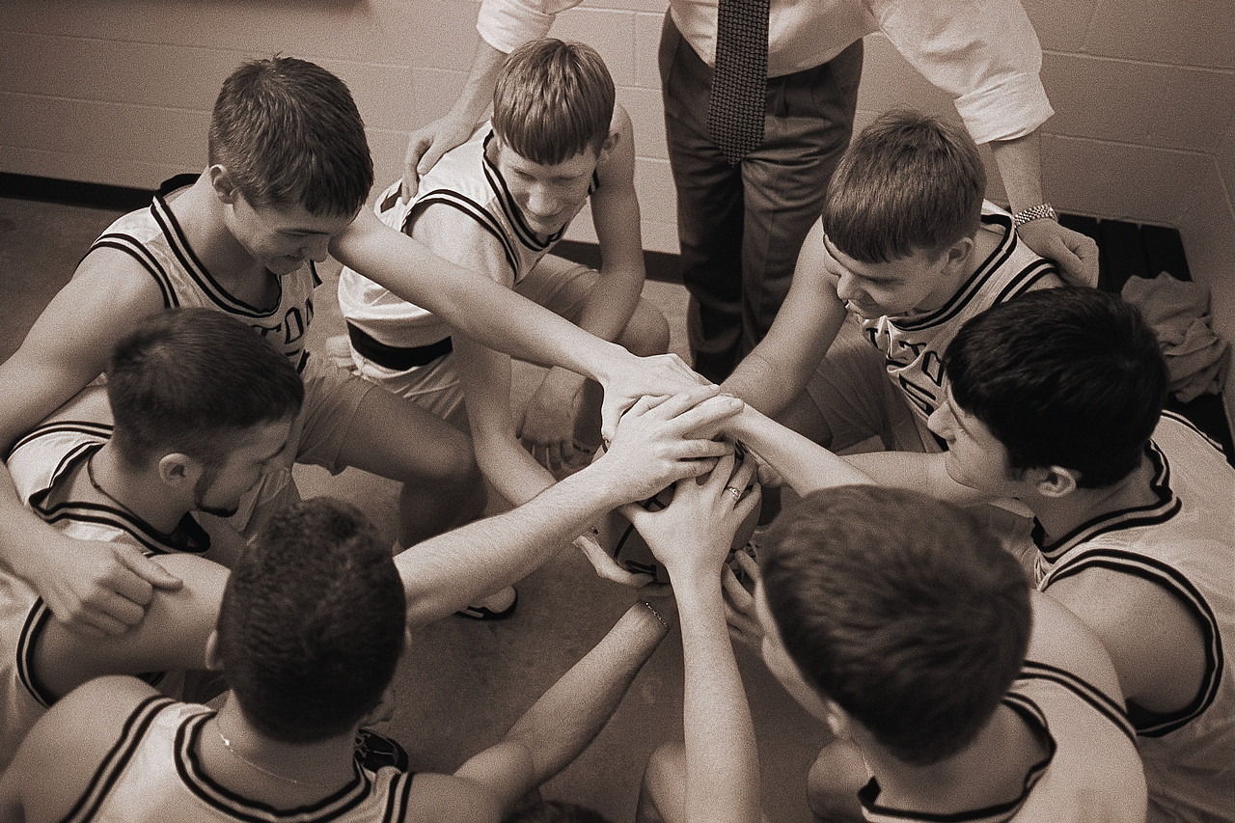
Tivoli Storage Manager Solutions for Hierarchical Storage Management – HSM deep dive day
Tivoli Storage Manager Solutions for Hierarchical Storage Management ─ Introduction
Fabián Kuhl – Teamleader Test
- IBM since 1994
- TSM since 2002
Dr. Stefan Bender – Lead Developer HSM for Windows & Unix clients
- IBM since 2000
- TSM since 2002

Slide 6
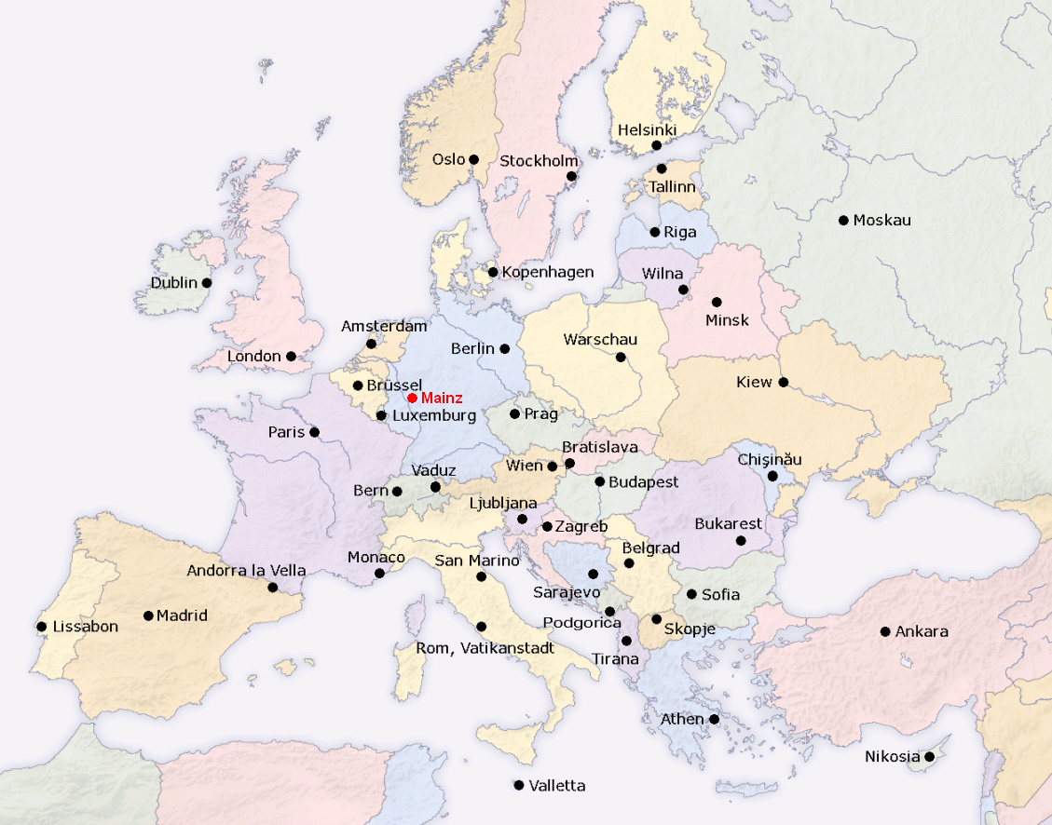
Tivoli Storage Manager Solutions for Hierarchical Storage Management – HSM deep dive day
Tivoli Storage Manager Solutions for Hierarchical Storage Management ─ Introduction
Tivoli Software Development Department
HSM Development is located in Mainz, Germany

Slide 7
Tivoli Storage Manager Solutions for Hierarchical Storage Management – HSM deep dive day
Tivoli Storage Manager Solutions for Hierarchical Storage Management ─ Introduction
Basic definition
HSM – Hierarchical Storage Management (non registered name)
TSM – Tivoli Storage Manager (IBM Tivoli product family)
Tivoli Storage Manager for Space Management – IBM HSM client for Unix and Linux
Tivoli Storage Manager HSM for Windows – IBM HSM client for Windows
Tivoli Storage Manager Server – The TSM Server containing the data pools

Slide 8
Tivoli Storage Manager Solutions for Hierarchical Storage Management – HSM deep dive day
Tivoli Storage Manager Solutions for Hierarchical Storage Management ─ Introduction
Basic definition
HSM – Hierarchical Storage Management (non registered name)
TSM – Tivoli Storage Manager (IBM Tivoli product family)
Tivoli Storage Manager for Space Management – IBM HSM client for Unix and Linux
→ HSM Unix client
Tivoli Storage Manager HSM for Windows – IBM HSM client for Windows
→ HSM for Windows client
Tivoli Storage Manager Server – The TSM Server containing the data pools

Slide 9

Tivoli Storage Manager Solutions for Hierarchical Storage Management – HSM deep dive day
Tivoli Storage Manager Solutions for Hierarchical Storage Management ─ Introduction

Slide 10
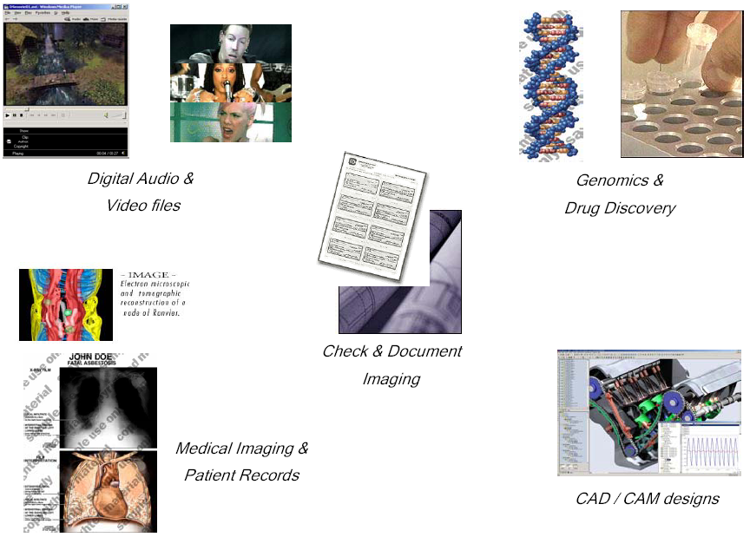

Tivoli Storage Manager Solutions for Hierarchical Storage Management – HSM deep dive day
Tivoli Storage Manager Solutions for Hierarchical Storage Management ─ Overview

Slide 11

Tivoli Storage Manager Solutions for Hierarchical Storage Management – HSM deep dive day
Tivoli Storage Manager Solutions for Hierarchical Storage Management ─ Overview
Customers pain points:
Amount of files and data on server rising uncontrolled
File size increases (for example music and video files)
Amount of users increases
High effort to administrate & backup
Rising costs for space on disks and hardware
Rising costs for energy of spinning disks
A lot of old and unused files (value of data!)

Slide 12
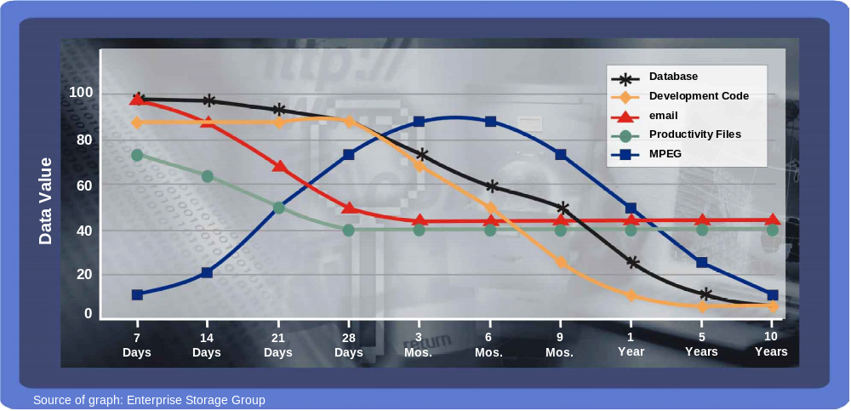
Tivoli Storage Manager Solutions for Hierarchical Storage Management – HSM deep dive day
Tivoli Storage Manager Solutions for Hierarchical Storage Management ─ Overview

Slide 13
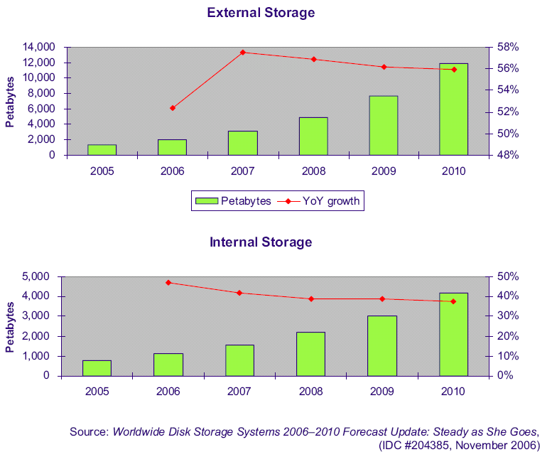
Tivoli Storage Manager Solutions for Hierarchical Storage Management – HSM deep dive day
Tivoli Storage Manager Solutions for Hierarchical Storage Management ─ Overview
→ Gartner is estimating an average growth for Storage (HSM and Archiving) of 28,6 % till 2010

Slide 14

Tivoli Storage Manager Solutions for Hierarchical Storage Management – HSM deep dive day
Tivoli Storage Manager Solutions for Hierarchical Storage Management ─ Overview
Definition (the TSM way)
HSM automatically migrates files from
on-line storage to less expensive near-line
storage (TSM Server), based on policy settings
Small stub files retain on disk, appearing
as the original files, thus ensuring
transparency of HSM for user applications
Stub files contain information pointing
to corresponding entry in TSM server DB
Migrated files are recalled automatically
back to disk as required

Slide 15




Tivoli Storage Manager Solutions for Hierarchical Storage Management – HSM deep dive day
Tivoli Storage Manager Solutions for Hierarchical Storage Management ─ Overview
TSM/HSM – part of green IT solution
Transparent
Archive & Recall
Reduce electrical
power consumption
through migration
to offline media
Optimization of
data storage
through policy based
media selection
Protection & Recovery
through close backup
integration

Slide 16
Tivoli Storage Manager Solutions for Hierarchical Storage Management – HSM deep dive day
Tivoli Storage Manager Solutions for Hierarchical Storage Management ─ Overview
TSM – Tivoli Storage Manager
TSM Clients
TSM Server
Backup/Archiv
Space Management (UNX HSM)
HSM for Windows
Backup Pool
Spaceman Pool
Archive Pool

Slide 17
Tivoli Storage Manager Solutions for Hierarchical Storage Management – HSM deep dive day
Tivoli Storage Manager Solutions for Hierarchical Storage Management ─ Overview
Supported platforms for current version TSM/HSM 5.5 (Unix Clients)
TSM for Space
Management (HSM)
AIX 5.3/6.1
jfs2 filesystems
AIX 5.3
mmfs (GPFS 3.2) filesystems
Linux x86 Sles10/RH5
mmfs (GPFS 3.2) filesystems
SOL 9/10 Sparc
Veritas 4.1 filesystems
HP IA64/PARISC 11i V2
Veritas 4.1 filesystems

Slide 18
Tivoli Storage Manager Solutions for Hierarchical Storage Management – HSM deep dive day
Tivoli Storage Manager Solutions for Hierarchical Storage Management ─ Overview
Supported platforms for current version TSM/HSM 5.5 (Windows Client)
Windows 2003 Server
Windows 2003 Server R2
Windows 2003 Enterprise Server
Windows 2003 Enterprise Server R2
→ all NTFS filesystems / 32bit
HSM for Windows

Slide 19
Tivoli Storage Manager Solutions for Hierarchical Storage Management – HSM deep dive day
Tivoli Storage Manager Solutions for Hierarchical Storage Management ─ Overview
Basic definitions
Archive | Backup & Recovery | HSM (WIN client) | HSM (Unix client)
“Archive” and “Retrieve” | “Backup” and “Restore” | “Migrate” and “Recall” | “Migrate” and “Recall”
Archived files on TSM Server (no copy on local storage) | Copied files on TSM Server (different versions of files for restore available) | Original Files with online access on local storage (stubs) | Original Files with online access on local storage (stubs)
Filesystems operations Standart API | Filesystems operations Standart API | Filesystems operations IFS (FS Filter – Kernel Extention) | Filesystems operations DMAPI
Rare access | Rare access (only for recovery) | Access user-defined | Access user-defined
No overwriting | New version of files (versioning on TSM Server) | overwriting | overwriting
TSM Server Archive Pool | TSM Server Backup Pool | TSM Server Archive Pool | TSM Server Spaceman Pool

Slide 20

Tivoli Storage Manager Solutions for Hierarchical Storage Management – HSM deep dive day
Questions?

Slide 21
Tivoli Storage Manager Solutions for Hierarchical Storage Management – HSM deep dive day
HSM deep dive day America 2008 – Overall Agenda
09:30 am - 10:15 am
Tivoli Storage Manager Solutions for Hierarchical Storage Management – Introduction & Overview (Fabián Kuhl)
10:15 am – 10:30 am
Break
10:30 am - 12:00 pm
Tivoli Storage Manager for Space Management (HSM for Unix) – Deep Dive (Fabián Kuhl)
12:00 pm - 01:00 pm
Lunch break
01:00 pm - 01:30 pm
Tivoli Storage Manager for Space Management – GPFS 3.2 (ILM & HSM interfaces) (Stefan Bender)
01:30 pm – 03:00 pm
Tivoli Storage Manager HSM for Windows – Overview and Innovation (Stefan Bender)
03:00 pm - 03:30 pm
Break
03:30 pm - 04:30 pm
Outlook TSM/HSM – Future Releases and best practices (Fabián Kuhl & Stefan Bender)
04:30 pm – 05:00 pm
Diskussion

Slide 22

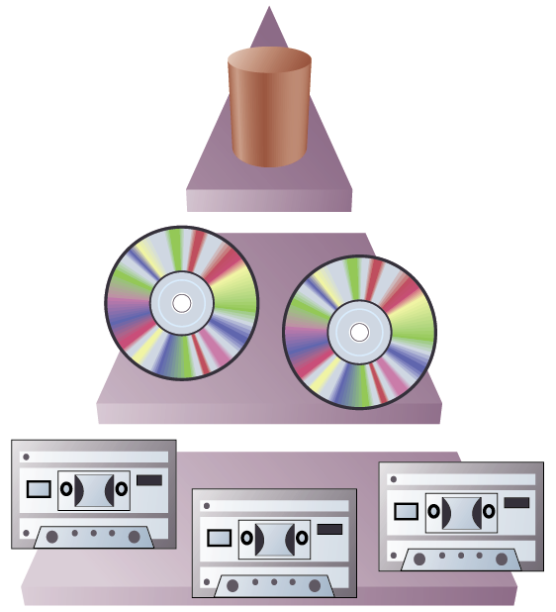

Tivoli Storage Manager Solutions for Hierarchical Storage Management – HSM deep dive day
Tivoli Storage Manager Solutions for Hierarchical Storage Management ─ Deep Dive
How does the Tivoli Storage Manager for Space Management work
auto migration
TSM for Space
Management (HSM)
TSM Server
Spaceman Pool
data migration
migrate
data recall
recall
Disk Pool
Local or attached online storage
with HSM managed filesystems
Tape Pool
Near line Storage

Slide 23
Tivoli Storage Manager Solutions for Hierarchical Storage Management – HSM deep dive day
Tivoli Storage Manager Solutions for Hierarchical Storage Management ─ Deep Dive
HSM definition | Explanation
Resident File | Origin file in HSM managed filesystem (no copy on TSM Server, file status “r”)
Migration | Copying origin file from near line storage to TSM Server Spaceman pool Substitute origin file on near line storage through stub file (file status “m”)
Stub file | Substituted original file (pointer to file on TSM Server, small file)
Premigration | Copying origin file from near line storage to TSM Server Spaceman pool Retaining origin file on near line storage (file status “p”, under HSM control)

Slide 24

Tivoli Storage Manager Solutions for Hierarchical Storage Management – HSM deep dive day
Tivoli Storage Manager Solutions for Hierarchical Storage Management ─ Deep Dive
HSM file status
ls -l output
dsmls output

Slide 25
Tivoli Storage Manager Solutions for Hierarchical Storage Management – HSM deep dive day
Tivoli Storage Manager Solutions for Hierarchical Storage Management ─ Deep Dive
HSM functions automigration
HSM Functions | Explanation
Automigration | Automatic copying origin file from near line storage to TSM Server Spaceman pool till low threshold is reached Substitute origin file on near line storage through stub file (file status “m”) Premigrating files (PM %) as defined for filesystem
Automigration trigger | Threshold migration: Triggers automigration in case of reaching high threshold of filesystem Demand migration: Triggers automigration in case of reaching 100 % filling level of filesystem User triggered automigration

Slide 26
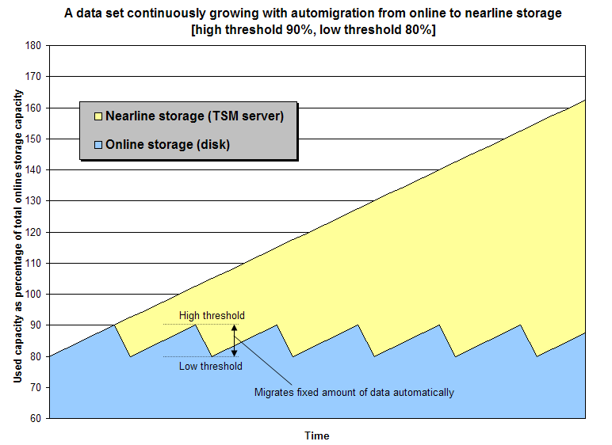
Tivoli Storage Manager Solutions for Hierarchical Storage Management – HSM deep dive day
Tivoli Storage Manager Solutions for Hierarchical Storage Management ─ Deep Dive

Slide 27
Tivoli Storage Manager Solutions for Hierarchical Storage Management – HSM deep dive day
Tivoli Storage Manager Solutions for Hierarchical Storage Management ─ Deep Dive
HSM functions recall options
HSM Functions | Explanation
Recall | Recalling origin file from TSM Server Spaceman pool to near line storage on local filesystem File status “p” if only read access to file, “r” if file got changed after recall
Partial File Recall (GPFS only) | Recalling only parts of origin file from TSM Server Spaceman pool to near line storage on local filesystem File status “p” if only read access to file, “r” if file got changed after recall
Streaming recall (GPFS, JFS2, SOL) | Recalling origin file from TSM Server Spaceman pool to near line storage on local filesystem, access file during recall possible (for example video file) File status “p” if only read access to file, “r” if file got changed after recall

Slide 28
Tivoli Storage Manager Solutions for Hierarchical Storage Management – HSM deep dive day
Tivoli Storage Manager Solutions for Hierarchical Storage Management ─ Deep Dive
The Daemons
HSM Daemons | Work to do
Recall Daemon | - Recalls migrated files back from TSM Server to local filesystem - Gets and answers mount events on DMAPI enabled filesystems
Monitor Daemon | - Monitors usage level of filesystem and starts process Automigration in case of usage above high threshold - Starts reconcile process
Scout Daemon | - Scans filesystem for valid candidates for automigration
Watch Daemon | - Controller daemon in cluster environment (GPFS, failover)
Root Daemon | - Non-root user action

Slide 29

Tivoli Storage Manager Solutions for Hierarchical Storage Management – HSM deep dive day
Tivoli Storage Manager Solutions for Hierarchical Storage Management ─ Deep Dive
The Daemons
ps –ef | grep dsm output

Slide 30
Tivoli Storage Manager Solutions for Hierarchical Storage Management – HSM deep dive day
Tivoli Storage Manager Solutions for Hierarchical Storage Management ─ Deep Dive
The Scout Daemon
Scout daemon scan the file system to find new and deleted files.
Creates Complete File Index (CFI), stores metadata information used for candidate selection.
HSM tools automatically update CFI during migrate, recall and restore activities.
Scout based on self updating metadata system.
Recovers from malfunction (CFI)
Scout scans
dsmc
Updates restored
File System
dsmautomig
Updates migrated
CFI
Metadata
File
dsmmigrate
Updates migrated
Updates recalled
dsmrecalld
New, deleted
dsmscoutd

Slide 31
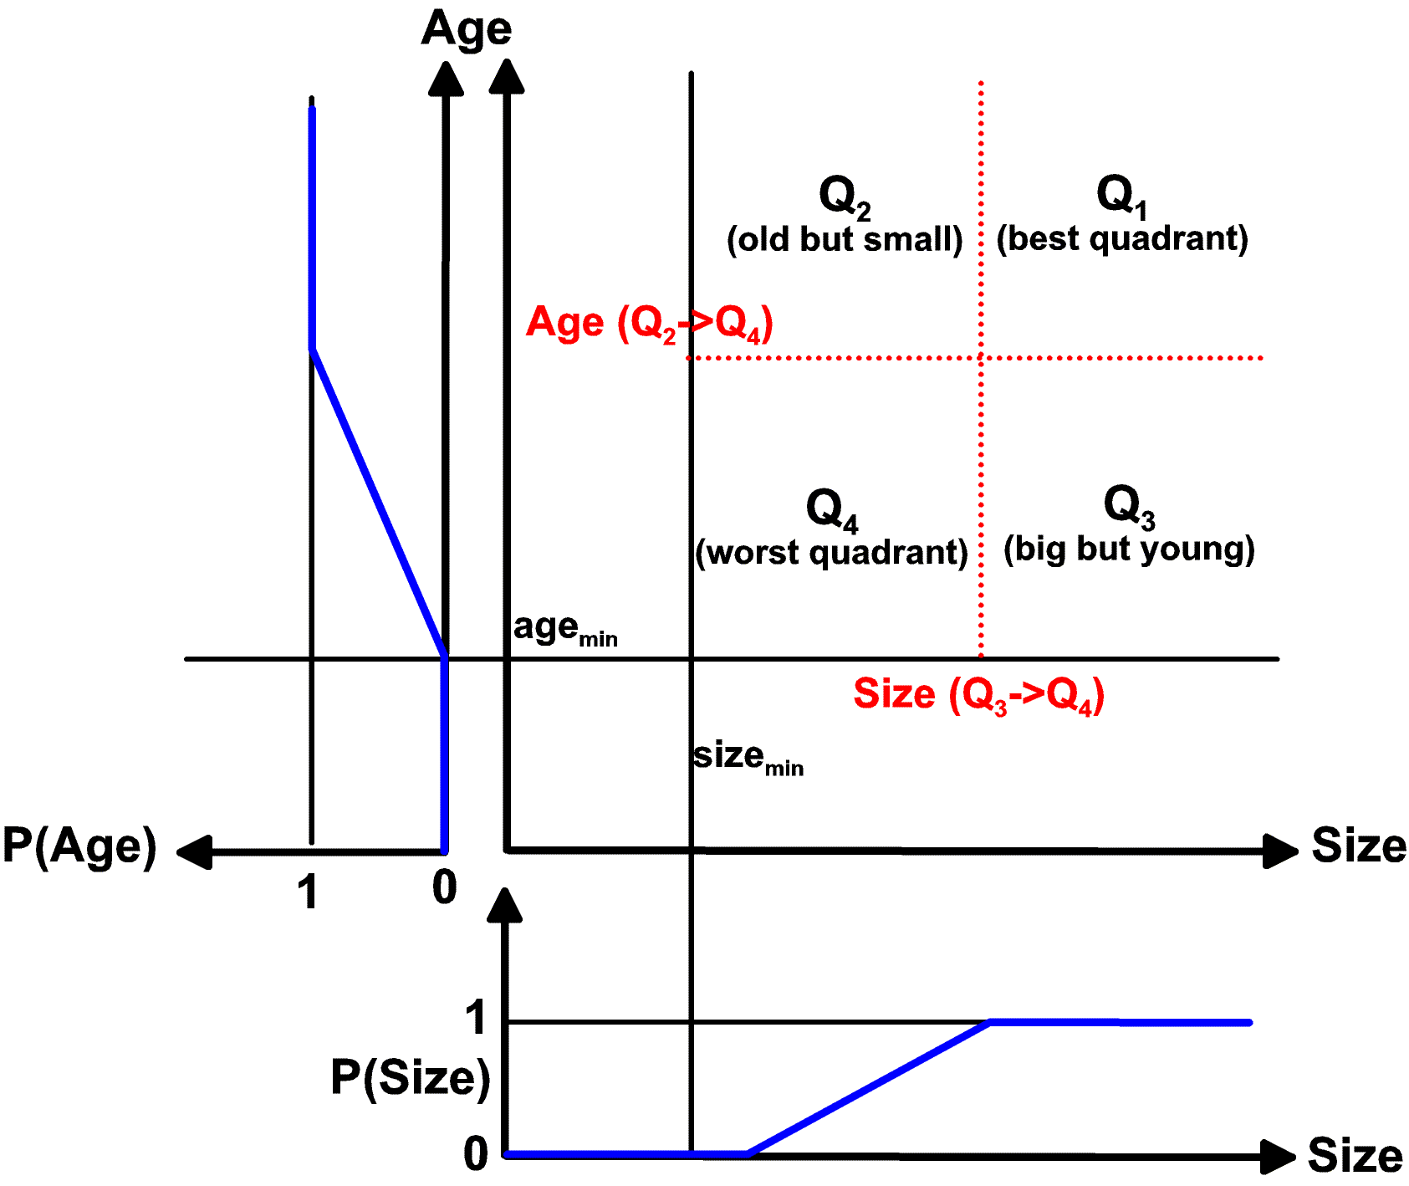
Tivoli Storage Manager Solutions for Hierarchical Storage Management – HSM deep dive day
Tivoli Storage Manager Solutions for Hierarchical Storage Management ─ Deep Dive
The Scout Daemon
A criteria for good candidates are files that are big and old. Also premigrated files.
Files are classified into four quadrants.
Boundaries are calculated based on a sample of files.
A random sample is representative for the distribution of size and age in the whole file system.
Files of Q₁ are migrated first, then Q₂ and Q₃
Quadrants are adapted automatically after each scan

Slide 32
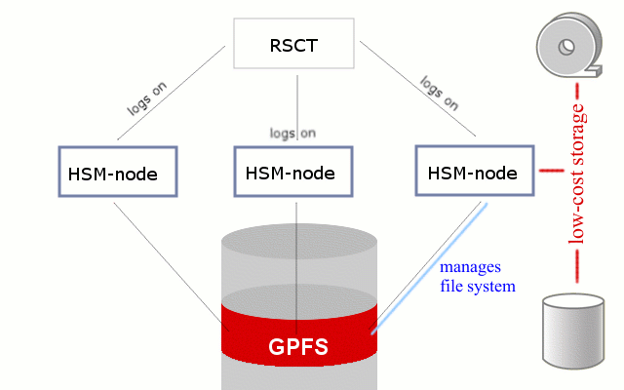
Tivoli Storage Manager Solutions for Hierarchical Storage Management – HSM deep dive day
Tivoli Storage Manager Solutions for Hierarchical Storage Management ─ Deep Dive
The Watch Daemon (GPFS filesystem)
dsmwatchd
dsmwatchd
dsmwatchd
RSCT – Reliable Scalable Cluster Technology

Slide 33
Tivoli Storage Manager Solutions for Hierarchical Storage Management – HSM deep dive day
Tivoli Storage Manager Solutions for Hierarchical Storage Management ─ Deep Dive
The Reconcile process
Reconciliation synchronizes HSM managed file system with the TSM server DB.
The CFI is like an image of the file system in metadata format.
The reconciliation uses the CFI to do fast queries
Deleted files in filesystem will be expired on TSM Server (stubs and premigrated files)
dsmc
Updates restored
File System
dsmautomig
Updates migrated
CFI
Metadata
File
dsmmigrate
Updates migrated
Updates recalled
dsmrecalld
Fs scan
New, deleted
dsmscoutd
Query
dsmreconcile
Query & Update
TSM Server

Slide 34
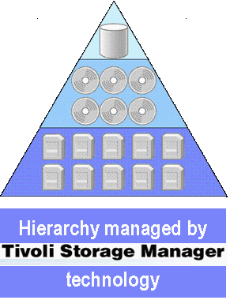

Tivoli Storage Manager Solutions for Hierarchical Storage Management – HSM deep dive day
Tivoli Storage Manager Solutions for Hierarchical Storage Management ─ Deep Dive
Backup integration – inline copy (backup)
TSM Server
UNIX File Server
File U
TSM HSM
Client
File System
Inline copy
TSM Backup
Client*
know the link!
(no network traffic)
Spaceman Pool
Stub U
File U
TSM
Server
Storage Pool
(Backup)

Slide 35
Tivoli Storage Manager Solutions for Hierarchical Storage Management – HSM deep dive day
Tivoli Storage Manager Solutions for Hierarchical Storage Management ─ Deep Dive
Backup integration – restore with migstate = yes
TSM Server
UNIX File Server
File U
TSM HSM
Client
File System
Recreating unique
object ID
TSM Backup
Client*
Storage Pool
(SPACEMGMT)
Stub U
restore
(–migstate=yes)
File U
TSM
Server
Storage Pool
(Backup)

Slide 36
Tivoli Storage Manager Solutions for Hierarchical Storage Management – HSM deep dive day
Questions?

Slide 37
Tivoli Storage Manager Solutions for Hierarchical Storage Management – HSM deep dive day
HSM deep dive day America 2008 – Overall Agenda
09:30 am - 10:15 am
Tivoli Storage Manager Solutions for Hierarchical Storage Management – Introduction & Overview (Fabián Kuhl)
10:15 am – 10:30 am
Break
10:30 am - 12:00 pm
Tivoli Storage Manager for Space Management (HSM for Unix) – Deep Dive (Fabián Kuhl)
12:00 pm - 01:00 pm
Lunch break
01:00 pm - 01:30 pm
Tivoli Storage Manager for Space Management – GPFS 3.2 (ILM & HSM interfaces) (Stefan Bender)
01:30 pm – 03:00 pm
Tivoli Storage Manager HSM for Windows – Overview and Innovation (Stefan Bender)
03:00 pm - 03:30 pm
Break
03:30 pm - 04:30 pm
Outlook TSM/HSM – Future Releases and best practices (Fabián Kuhl & Stefan Bender)
04:30 pm – 05:00 pm
Diskussion

Slide 38

Tivoli Storage Manager Solutions for Hierarchical Storage Management – HSM deep dive day
Break!

